Slide 1

Tuesday September 29 ,2021
UNIT ONE
MY HOBBIES
Period 5
SKILLS 1

Slide 2
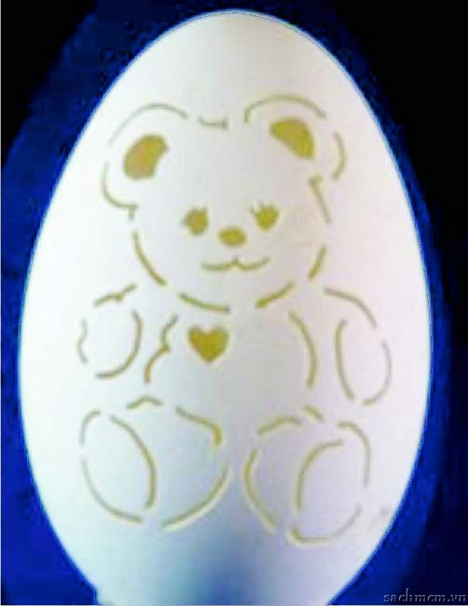
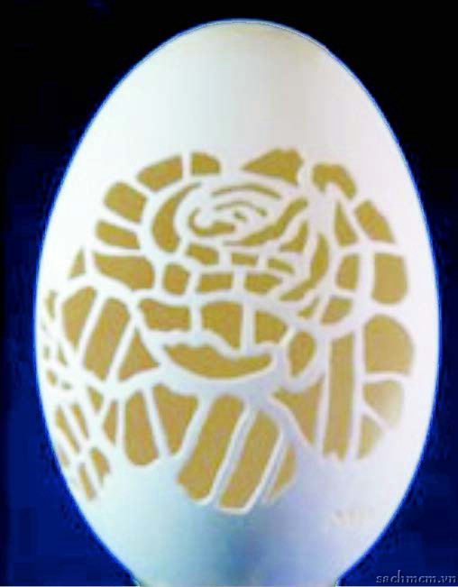
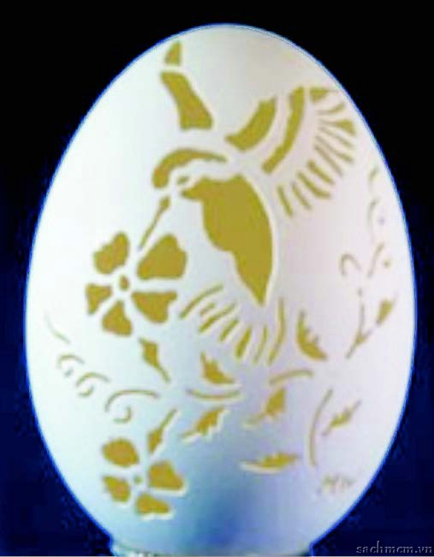
Who is the fastest?
What can you see from the pictures?
a teddy bear, a flower, a bird and flowers.
2. What do you think the objects are made of?
They are made of eggshells.
3. Can you guess what hobby it is?
The hobby is carving eggshells.

Slide 3
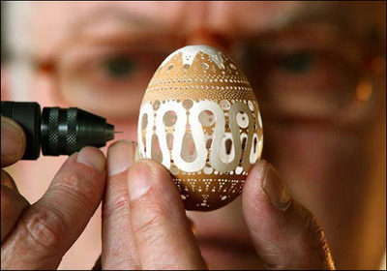
Nick’s father’s unusual hobby

Slide 4
1. Work in pair. Ask and answer the questions.(Ex. 1/p. 12)
Read the text about
Nick’s father’s unusual hobby
and check your answers

Slide 5
Now, read about Nick’s father unusual hobby and check your answers.
My father has an unusual hobby: carving eggshells. As everyone knows, eggshells are very fragile. My dad can make beautiful pieces of art from empty eggshells. It’s amazing!
He started the hobby five years ago after the trip to the US where he saw some carved eggshells in an art gallery. My father did not go to class to learn how to carve. He learned everything from the Internet.
Some people say that this hobby is difficult and boring, but it isn’t. All you need is time.
It may takes two weeks to complete one shell. I find this hobby interesting because carved eggshells are unique gifts for family and friends. I hope that in the future he’ll teach me how to do eggshells carving.

Slide 6
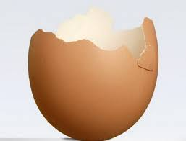
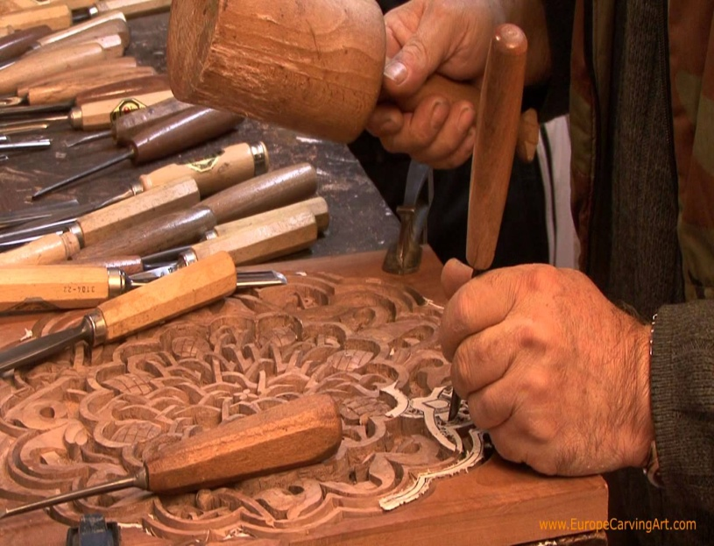
Unit 1. MY HOBBIES
Lesson 5. Skills 1
I. Read : 1.Vocabulary:
- eggshell (n)
: vỏ trứng
- carved (adj)
: được chạm, khắc
- fragile (adj)
: dễ vỡ
- unique (adj)
: độc đáo
- a piece of art (n) :
: tác phẩm nghệ thuật
(to)be made of
: được làm bằng
- (to) complete
: hoàn toàn

Slide 7
2.Read the text and answer the questions. (Ex. 2/p.12)
Why does Nick think his father’s hobby is unusual?
Where did his father see the carved eggshells for the first time?
3. How do some people find this hobby?
4. Does Nick like his father’s hobby?

Slide 8

LUCKY NUMBER
1
6
A
B
2
20
50
60
40
30
10
70
20
30
40
10
50
60
5
70
7
3
4

Slide 9
Why does Nick think his father’s hobby is unusual?
Because eggshells are very fragile and his father can make
beautiful pieces of art from empty ones.

Slide 10
2. Where did his father see the carved eggshells for the first time?
He saw the carved eggshells for the first time in an
art gallery in the US.

Slide 11
3. How do some people find this hobby ?
They find it difficult and boring.

Slide 12
4. Does Nick like his father’s hobby?
Yes, he does.

Slide 13

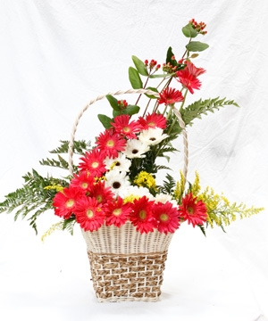
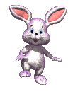

Lucky number

Slide 14
2. Read the text and answer the questions
My father has an unusual hobby: carving eggshells. As everyone knows, eggshells are very fragile. My dad can make beautiful pieces of art from empty eggshells. It’s amazing!
He started the hobby five years ago after the trip to the US where he saw some carved eggshells in an art gallery. My father did not go to class to learn how to carve. He learned everything from the Internet.
Some people say that this hobby is difficult and boring, but it isn’t. All you need is time.
It may takes two weeks to complete one shell. I find this hobby interesting because carved eggshells are unique gifts for family and friends. I hope that in the future he’ll teach me how to do eggshells carving.
Why does Nick think his father’s hobby is unusual?
Where did Nick’s father see the carved eggshells for the firs time?
How do some people find this hobby?
Does Nick like his father hobby?
Because eggshells are fragile and his father can make beautiful pieces of art from empty eggshells.
He saw them in an art gallery in USA.
They find it difficult and boring.
Yes, he does.

Slide 15
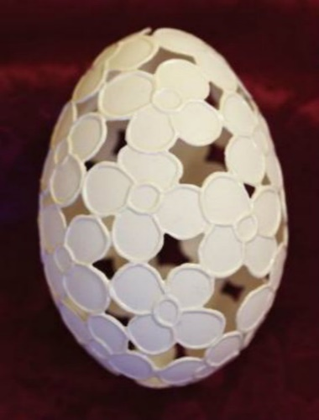
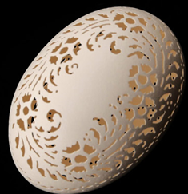
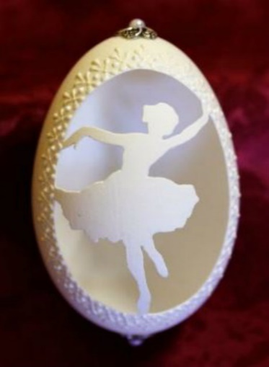
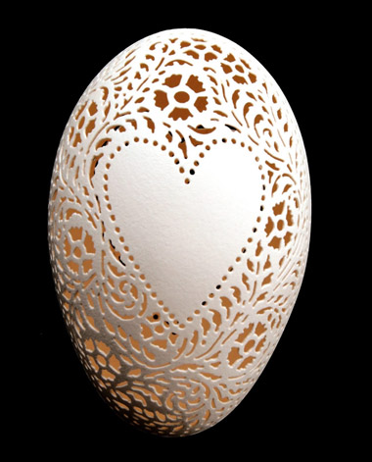
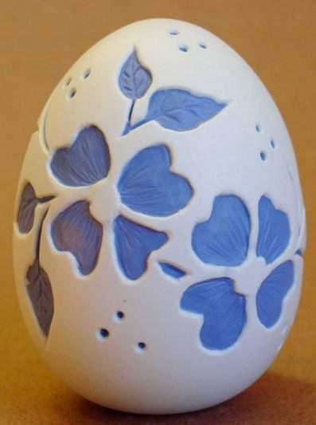
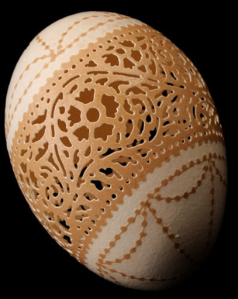
3. Read the sentences below and use no more than three words from the text to complete them.
Nick’s father’s hobby
Nick’s father enjoys ……………………..
4. Nick thinks you can learn to carve if you have …….. .
carving eggshells.
time
2. He took up this hobby when he came back home from …………………… .
5. Carved eggshells can be used as ……. for your family and friends.
3. He learned to carve from …………….. .
gifts
the Internet
the US / the USA

Slide 16
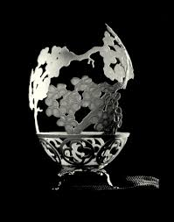
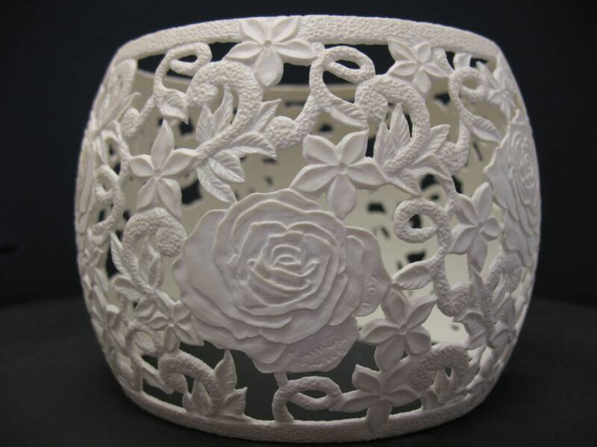
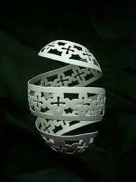
4. Nick says that carved eggshells can be used as gifts for your family and friends. In pairs, discuss other uses of these pieces of artwork. Share your ideas with the class

Slide 17
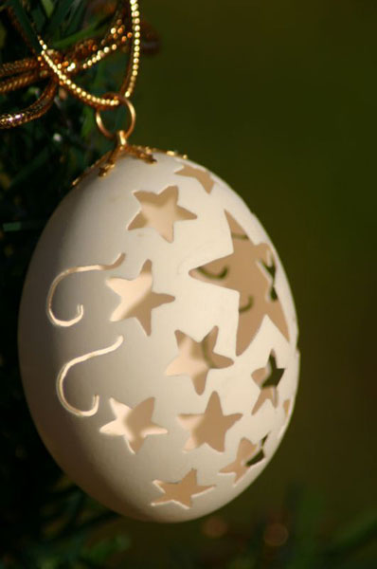
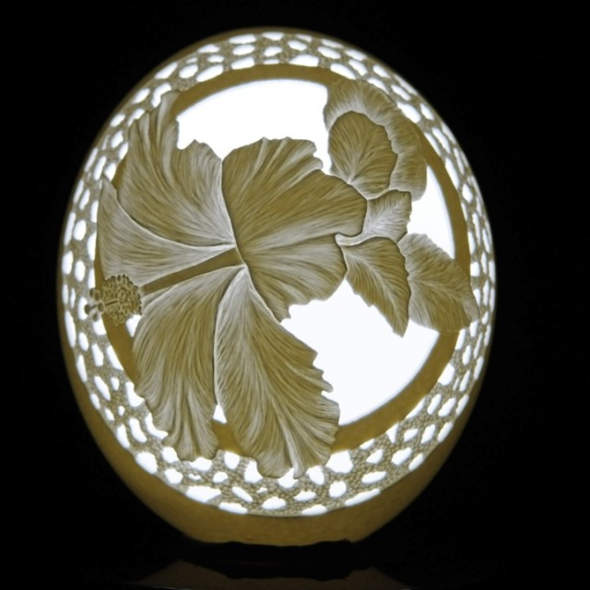
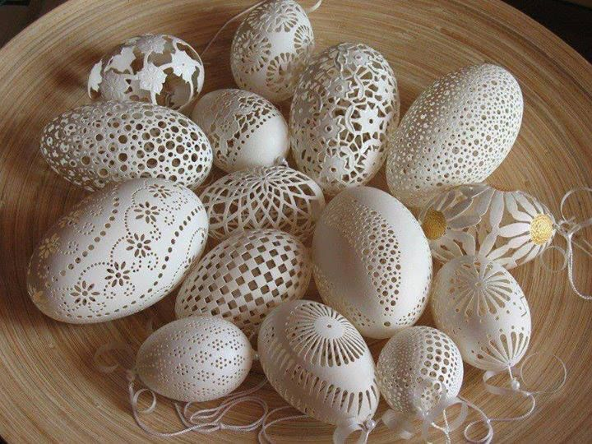
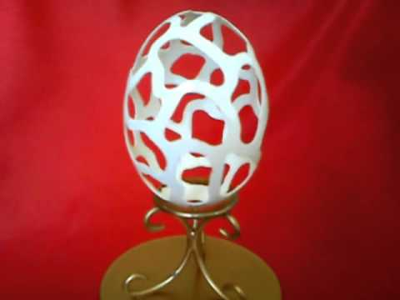
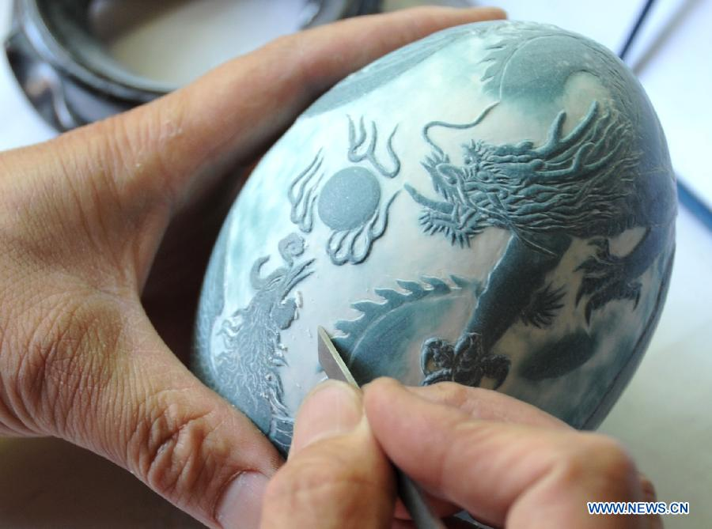
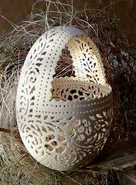
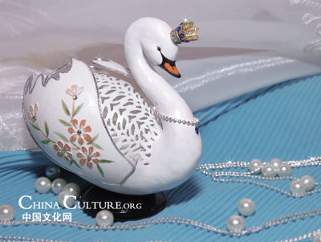
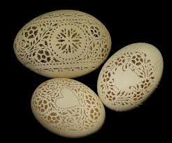
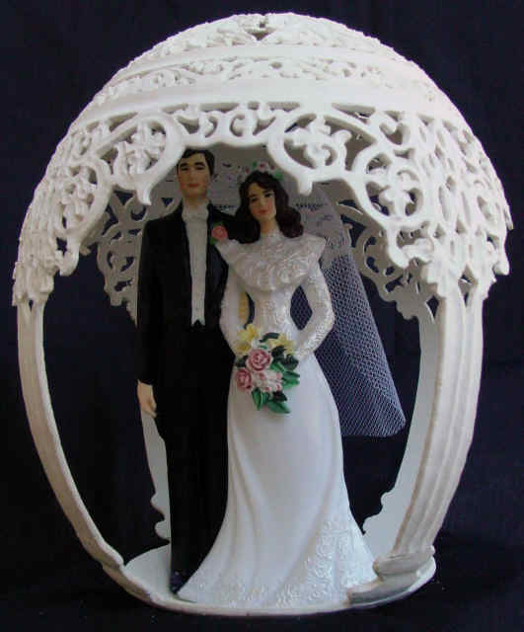
III. Speaking
1.Discussion:
What other uses of these pieces of artwork?

Slide 18
II. SPEAKING
1. Speaking. Ex. 4/p.12
bells
gifts
WHAT CAN What can carved eggshells
be used for?
lights
decorate home
toys

Slide 19

III Speaking.2Talk about your hobby , use cued questions :
What is the name of your hobby?
When did you start your hobby?
Is your hobby difficult or easy? Why?
Is your hobby useful or not? Why?
Do you intend to continue your hobby in the future?
Who do you
think has
the most exciting hobby?

Slide 20
Homework
* Learn new words.
* Talk about your hobby
* Prepare SKILLS 2.

Slide 21


